Slide 1

User Engagement Analyst
Compare the Market is a price comparison website based in the UK.
By Hiren Dodia

Slide 2
Dataset overview
UserID: This is a unique identifier for each user.
Age: Represents the age of each user, ranging from young adults to seniors.
Recency: Indicates user activity status with labels like "Active," "Inactive," and "Dormant."
Account: This appears to be a binary field with values "0" and "1."
LastProduct: Specifies the last product category the user interacted with, such as "Car," "Home," or "Money."
UserSegment: This seems to categorize users into different segments labeled as "A“, "B" and "C."

Slide 3
Data Pre-processing
Data Cleaning
Identify and handle missing values: Where there were 493 records found NULL and missing values in column such as UserSegment, Recency, Account, LastProduct.
Remove duplicates: Ensure no duplicate UserID records exist.
Standardize data formats:
Convert Age to integers.
Standardize categorical values for fields like Recency and LastProduct
Data Transformation
Age bracket – calculated column
Measures – Churn rate, Calculated measures for active, dormant, inactive users etc

Slide 4
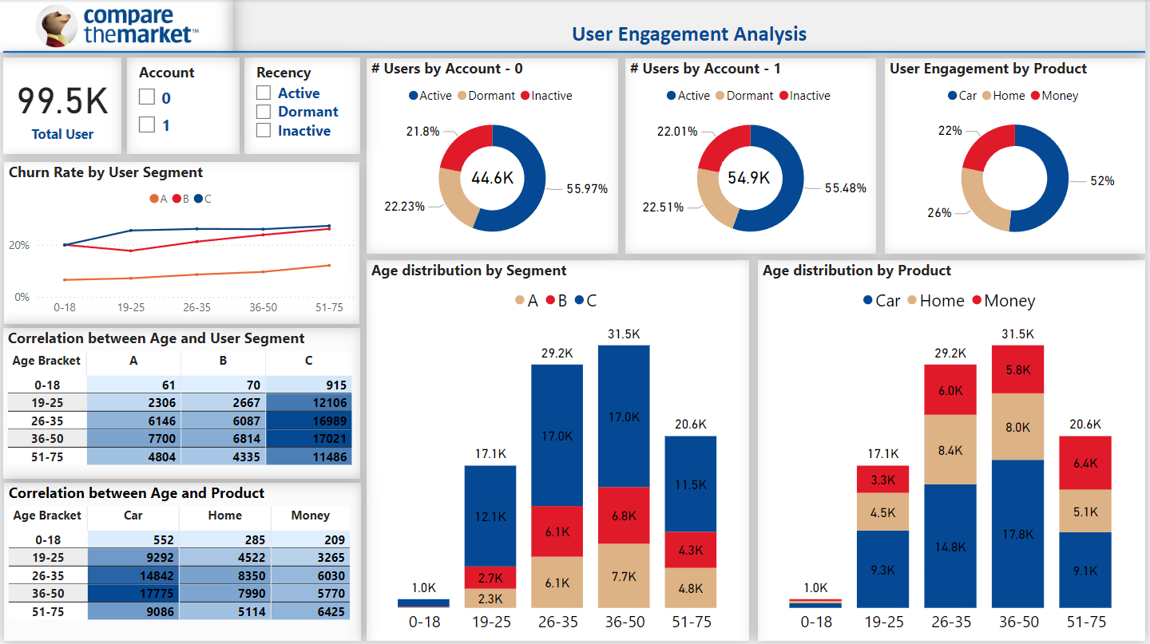

Slide 5
Challenges
Data Quality Issues
Imbalanced Data Distribution
Demographic Limitations
Engagement Complexity
Product Insights
Interpretation and Scalability

Slide 6
Recommendation
Invest in Car Product Engagement: Since Car is the most popular product, consider further investment in this category to maintain or grow engagement.
Target Age Group 26-50: With high engagement in the 26-50 age brackets, campaigns or product enhancements could focus on maintaining this demographic.
Re-Engage Older Users: The 51-75 age bracket shows a significant number of dormant users, indicating potential for re-engagement campaigns tailored for this demographic.
Improve Engagement with Segment B: Since Segment B has the lowest engagement with 27.5%, consider targeted strategies to increase their interaction with the platform.

Slide 7
THANK YOU…

